Slide 1
Analysis of ML Algorithms
Team Members :
Atul, Mourya, Prabal, Rahul, Shambhavi

Slide 2
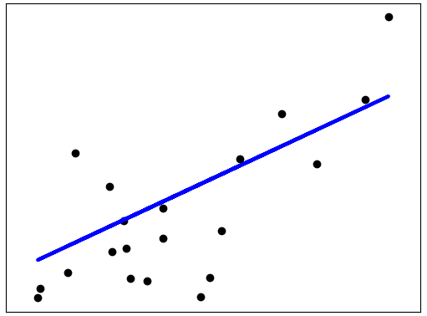

Linear Regression
Predicting the output of a dependent variable (Y) when there are any changes in the values of independent variables (X)
$$y=b0+b1x$$

Slide 3
Advantages & Disadvantages
Advantages
Disadvantages
+ Simplicity of Algorithm
+ Easy and intuitive to use and understand
+ Works in all cases, even when it doesn’t fit the data exactly, we can use it to find the nature of relationship between two variables
+ Perfect tool to test a hypothesis before diving into execution
- Assumes relationships to be linear
- It over simplifies many real world problems
- Doesn’t work with categorical variable
- Linear Regression is sensitive to outliers.
(Outliers are surprising data)

Slide 4
Possible Real Life Usage
Getting Insights on customer behavior
Understanding factors that affect business profits
Evaluation of current trends to make estimates/forecast
Insurance companies heavily rely on regression analysis to estimate the credit standing of policyholders and a possible number of claims in a given time period.

Slide 5
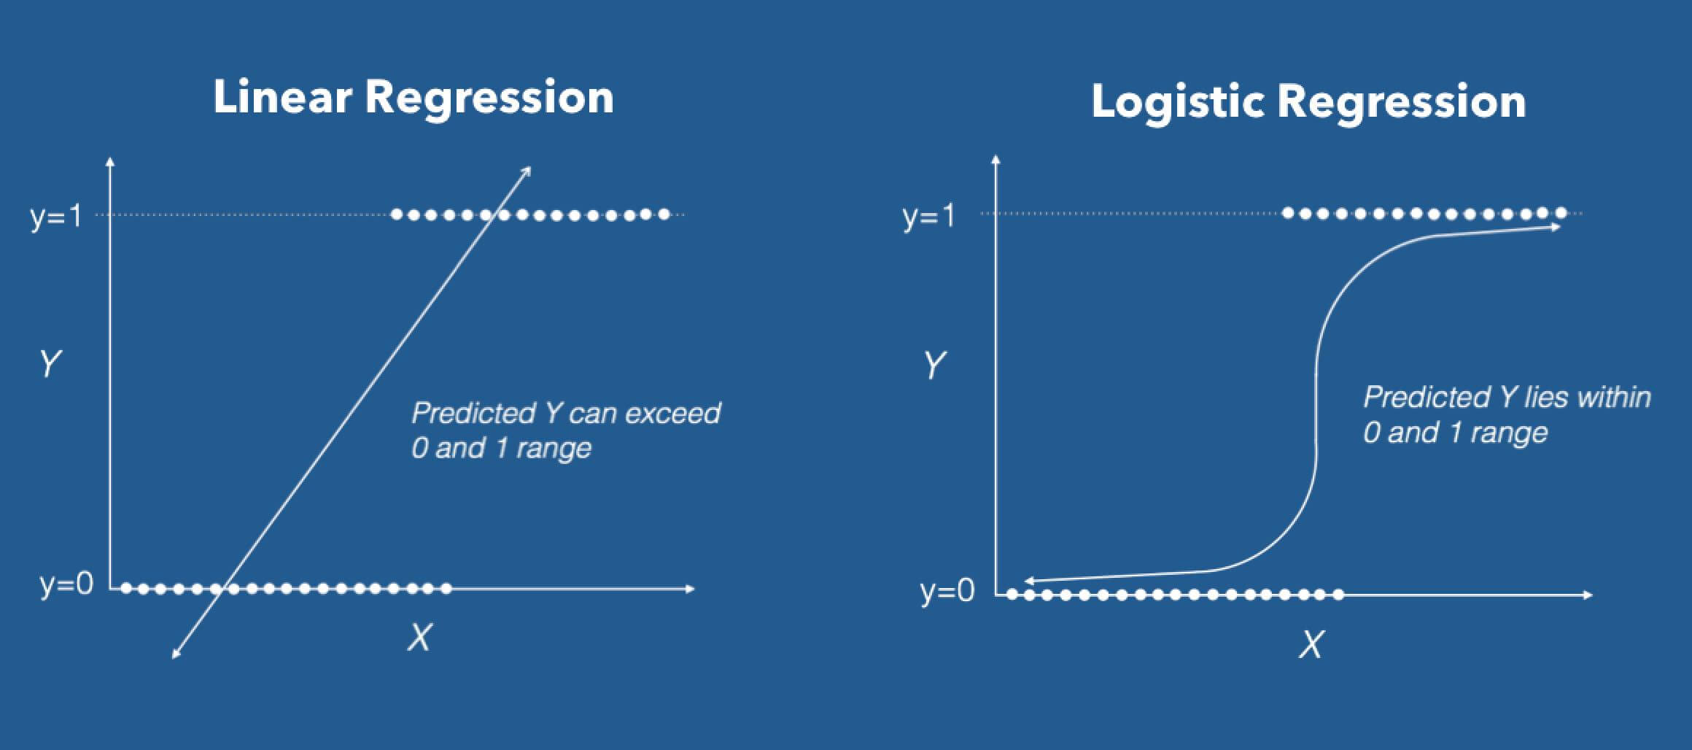
LOGISTIC REGRESSION
Linear Regression fails when Y variable is categorical.
So what would you do when the Y is a categorical variable with 2 classes?
Logistic regression can be used to model and solve such problems, also called as binary classification problems.
P(z)=1/(1+e^-z)

Slide 6
ADVANTAGES & DISADVANTAGES
Advantages
Disadvantages
+ Easy to interpret
+ It does not assume a linear relationship between the IV and DV
- Logistic regression tends to underperform when there are multiple or non-linear decision boundaries.
- They are not flexible enough to naturally capture more complex relationships.
- Logistic regression in effect has no more assumptions than many other methods, and one can be misled by choosing an improper accuracy scoring rule.

Slide 7
POSSIBLE REAL LIFE USAGE
Spam Detection : Predicting if an email is Spam or not
Credit Card Fraud : Predicting if a given credit card transaction is fraud or not
Health : Predicting if a given mass of tissue is benign or malignant
Marketing : Predicting if a given user will buy an insurance product or not
Banking : Predicting if a customer will default on a loan.

Slide 8
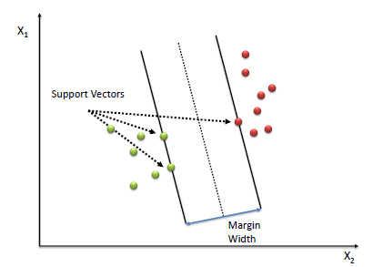
Support Vector Machine
It is a supervised learning algorithm
It performs classification by finding the hyperplane that maximizes the margin between the two classes. The vectors (cases) that define the hyperplane are the support vectors.

Slide 9
Advantages and Disadvantages
Advantages
Disadvantages
+ SVM works well when the relationship b/w features is unknown.
+ Works well with even unstructured and semi structured data like text, Images and trees.
+ The kernel function is real strength of SVM. We can solve any complex problem.
+ It scales relatively well to high dimensional data.
+ The risk of overfitting is less in SVM.
- Choosing a “good” kernel function is not easy.
- Long training time for large datasets.
- Difficult to understand and interpret the final model, variable weights and individual impact.
- Since the final model is not so easy to see, we can not do small calibrations to the model hence its tough to incorporate our business logic.

Slide 10
Possible real life usage
Protein Structure Prediction
Intrusion Detection
Handwriting Recognition
Detecting Steganography in digital images
Breast Cancer Diagnosis

Slide 11
NAÏVE BAYES
Naive Bayes methods are a set of supervised learning algorithms based on applying Bayes’ theorem with the “naive” assumption of independence between every pair of features.

Slide 12
ADVANTAGES & DISADVANTAGES
Advantages
Disadvantages
+ NB models are very simple.
+ They can scale with dataset.
+ Need less training data.
+ Not sensitive to irrelevant features.
+ Handles continuous and discrete data.
- NB models are often beaten by models properly trained and tuned.
- Takes more runtime memory compared to other algorithms.

Slide 13
Possible REAL LIFE USAGE
Text document classification
Spam detection
https://cloud.google.com/blog/big-data/2018/01/problem-solving-with-ml-automatic-document-classification

Slide 14
K-MEANS CLUSTERING
K-means clustering is a type of unsupervised learning, which is used when you have unlabeled data (i.e., data without defined categories or groups). The goal of this algorithm is to find groups in the data, with the number of groups represented by the variable K.

Slide 15
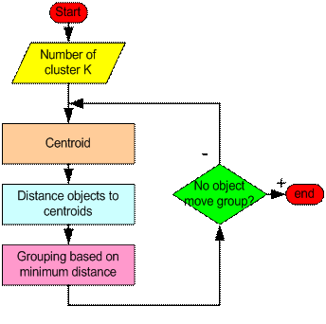
How the K-Mean Clustering algorithm works?

Slide 16
Advantages and Disadvantages
Advantages
Disadvantages
+ Easy to implement
+ With a large number of variables, K-Means may be computationally faster than hierarchical clustering
+ An instance can change cluster (move to another cluster) when the centroids are re-computed.
- Difficult to predict the number of clusters (K-Value)
- Initial seeds have a strong impact on the final results
- The order of the data has an impact on the final results
- Sensitive to scale

Slide 17
Possible real life usages
Behavioral segmentation:
Inventory categorization:
Sorting sensor measurements:
Detecting bots or anomalies:

Slide 18
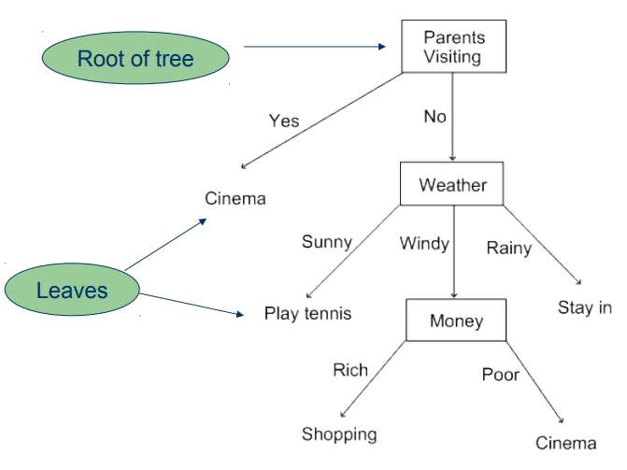
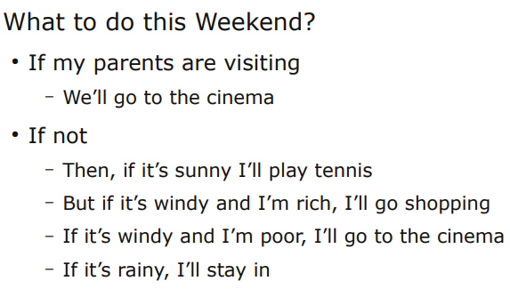
Tree based aLGORITHMS
Complex decisions can often be expressed in terms of a series of questions:

Slide 19
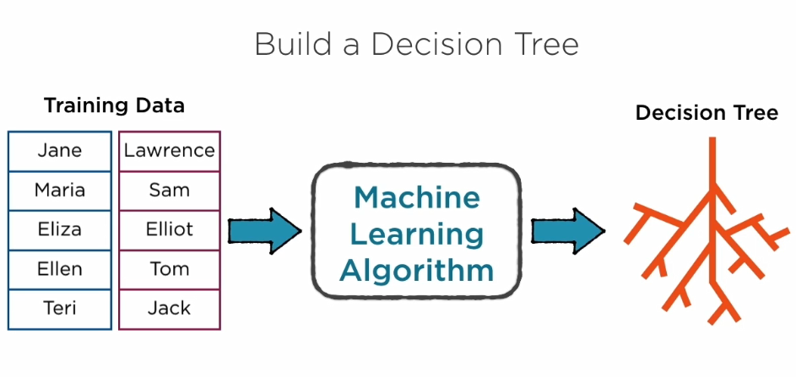
Decision Tree

Slide 20
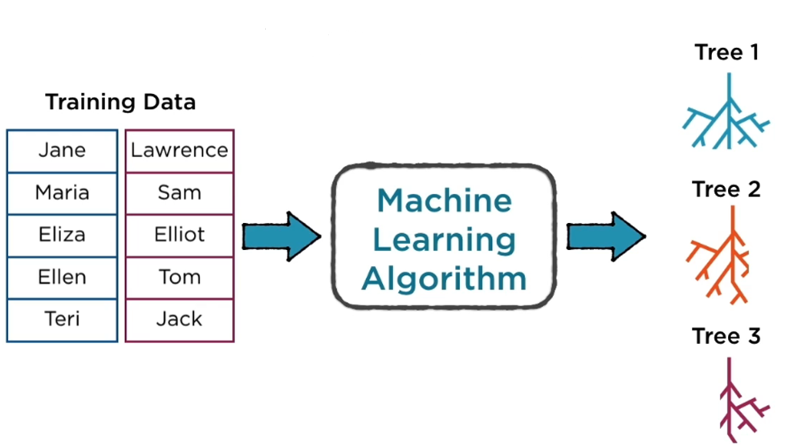
Random Forest

Slide 21
Advantages & disadvantages
Advantages
Disadvantages
+ Decision Trees are easy to explain. It results in a set of rules.
+ It follows the same approach as humans generally follow while making decisions.
+ Interpretation of a complex Decision Tree model can be simplified by its visualizations. Even a naive person can understand logic.
+ The Number of hyper-parameters to be tuned is almost null.
- There is a high probability of overfitting in Decision Tree.
- Generally, it gives low prediction accuracy for a dataset as compared to other machine learning algorithms.
- Information gain in a decision tree with categorical variables gives a biased response for attributes with greater no. of categories.
- Calculations can become complex when there are many class labels.

Slide 22
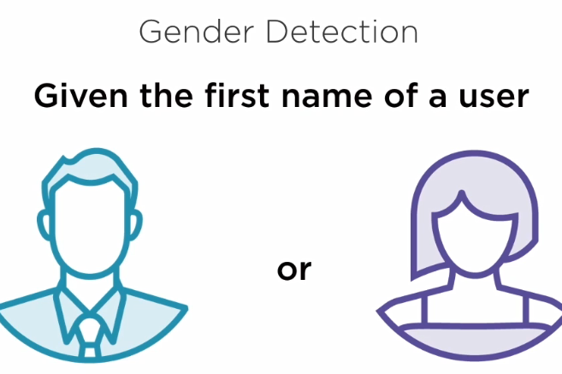
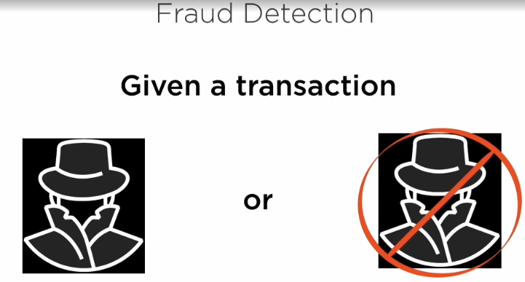
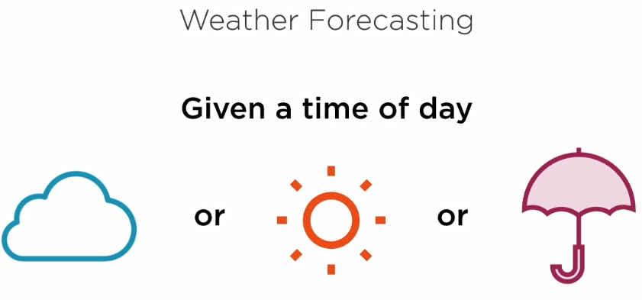
Possible real-life usages

Slide 23
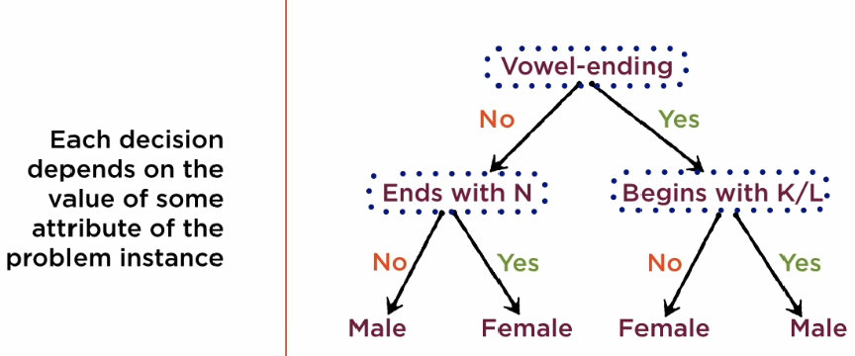
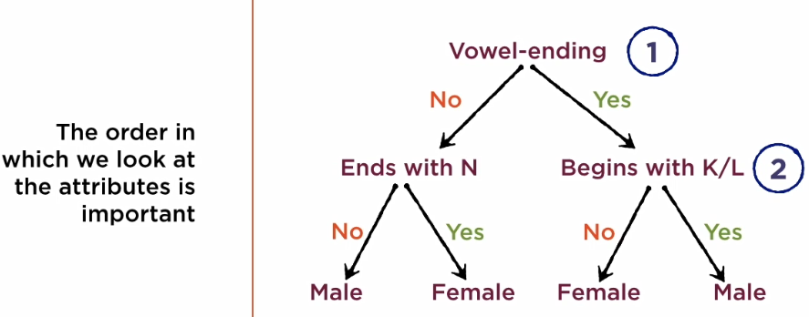
Gender Detection Scenario

Slide 24
Comparative analysis of different classifiers

Slide 25
 | Naïve Bayes | Logistic Regression | Linear Regression | Support Vector Machine | K means Clustering | Random Forest | Decision Trees
Type of Learning | Supervised Learning Algorithm | Supervised Learning Algorithm | Supervised Learning Algorithm | Supervised Learning Algorithm | Unsupervised Learning Algorithm | Supervised Learning Algorithm | Supervised Learning Algorithm
Used for | Classification | Classification | Prediction | Classification | Clustering | Classification and regression | Classification and regression
Type of model | For the given features (x) and the label y, it estimates a joint probability from the training data. Hence this is a Generative model | Estimates the probability(y/x) directly from the training data by minimizing error. Hence this is a Discriminative model | Predicts the value by using the values of dependent variables on a linear equation | For the given independent variables hyperplanes are calculated geometrically. Thus it is a separative model. | For the given unlabeled dataset the dataset is clustered depending on the distance they are from the centroid. | Measures the relative importance of each feature on the prediction. | Creates rules for classification or prediction.

Slide 26
 | Naïve Bayes | Logistic Regression | Linear Regression | Support Vector Machine | K means Clustering | Random Forest | Decision Trees
Cost Function | argmax |c∈C| P(c|d) = argmax |c∈C| P(d|c)P(c) P(d) | S(z)=1/(1+e^−z) s(z) = probability estimate z = input to the function e = base of natural log | J(θ)=1/2∑^{m}_{i=1}(hθ(x(i))−y(i))² | ξ_{i}=max(0,1−y_{i}(ωx_{i}+b)) f(w)=∥w∥²/2+C(∑_{i=1}^{N}ξ)^{k} | cost(T) = ∑_{x∈S} min_{z∈T} ||x − z|| ² | No cost function. Rules are defined for decision. | No cost function. Rules are defined for decision.
Assumptions | Model assumes all the features are conditionally independent | It the splits feature space linearly, it works well even if some of the variables are correlated | The mean of residuals is equal to zero and the variables follow linear relationship | No specific assumption | All variables have the same variance | No assumptions to make. | Root node has to be assumed for the first iteration.

Slide 27
 | Naïve Bayes | Logistic Regression | Linear Regression | Support Vector Machine | K means Clustering | Random Forest | Decision Trees
Limitations | Works well even with less training data, as the estimates are based on the joint density function | With the small training data, model estimates may over fit the data | Linear regressions are sensitive to outliers. It is meant to describe linear relationships between variables. So, if there is a nonlinear relationship, then it will have a bad model. | Very cumbersome for multiclass problems | The number of cluster, K, must be determined before hand and we never know which attribute contributes more to the grouping process since we assume that each attribute has the same weight. | A large number of trees can make the algorithm to slow and ineffective for real-time predictions. | Identification of root node is an NP- hard problem.

Slide 28
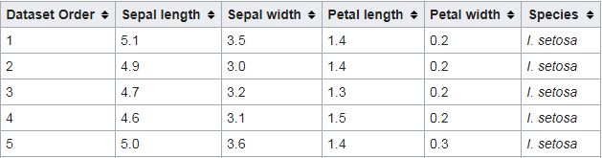
Analysis Using IRIS DataSET
This is perhaps the best known database to be found in the pattern recognition literature.
Attribute Information:
1. sepal length in cm 2. sepal width in cm 3. petal length in cm 4. petal width in cm 5. class: -- Iris Setosa -- Iris Versicolour -- Iris Virginica

